Slide 1
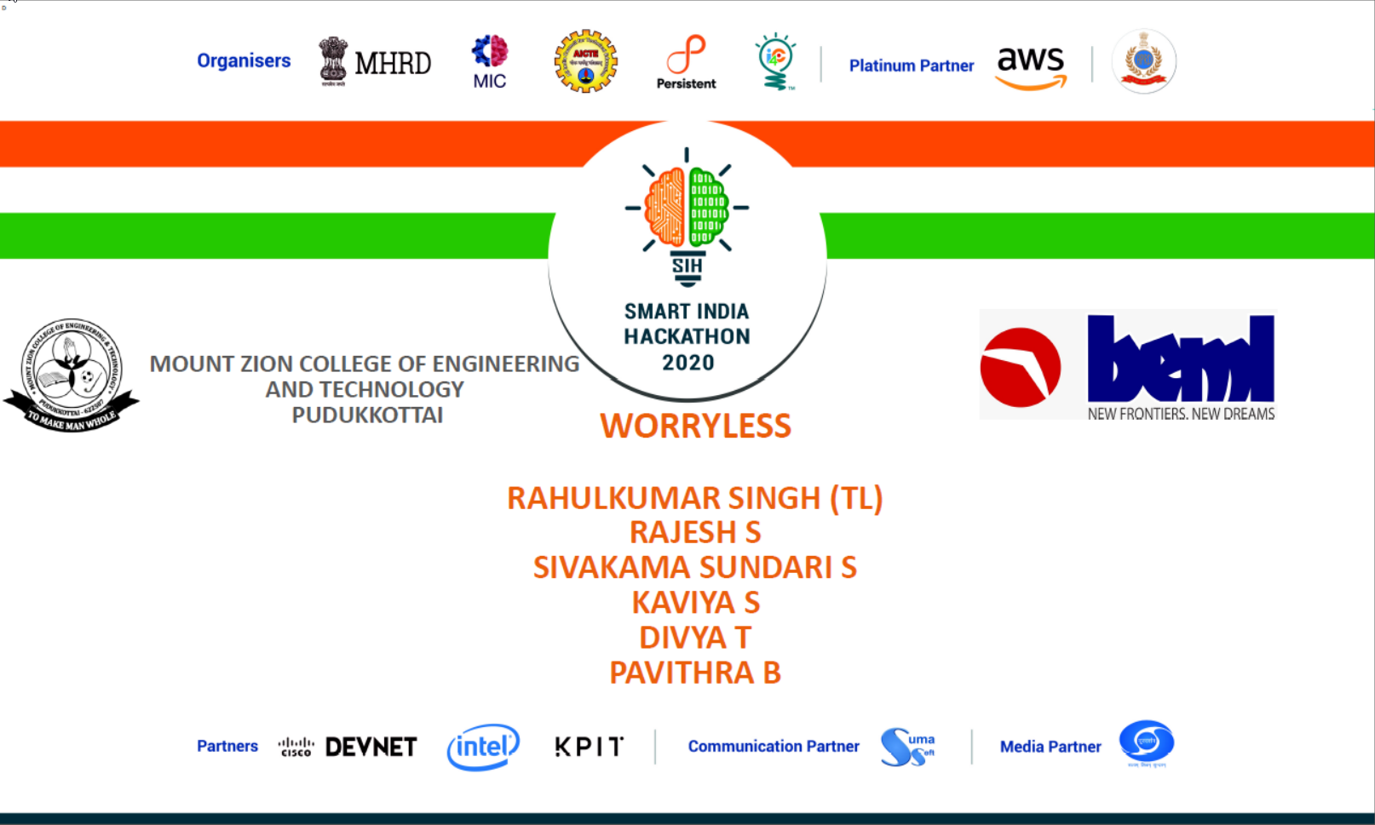

Slide 2
BH60M & BH100 with Electronic Transmission
Securing the CAN J1939 2.0B Communication Protocol, to make RIDES SAFER!

Slide 3
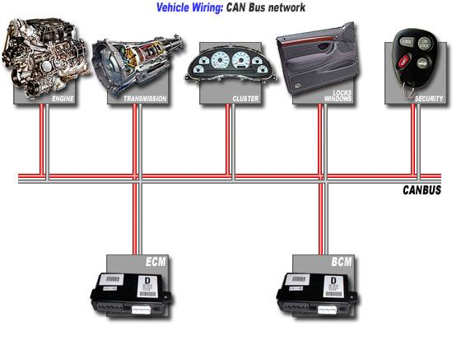
NETWORK SEGMENTATION
SEGREGATE EACH NODES:
R&S
R&S
R&S

Slide 4
SWITCH
Data packets is directed to only the intended destination port.
Data packets arrives the switch.
Match the ports by MAC address.
Reduces unnecessary traffic.
Can detect any frame and keeps the record of MAC address

Slide 5
ROUTER
Receives data packets by the IP address.
Determines whether the packet is meant for own network.
Receives the own data.
Only allows the intended data packets to the network.
False data will be rejected by the router.

Slide 6
EXCHANGE DATA BETWEEN DIFFERENT NODES
Data packets has to leave the node and search for what node is meant for that.
To find that it will reach the router.
Router checks for the IP and forward it to the next router if it is not the destination.
Switches create network and router connects the network.

Slide 7
THANK YOU

